Slide 1
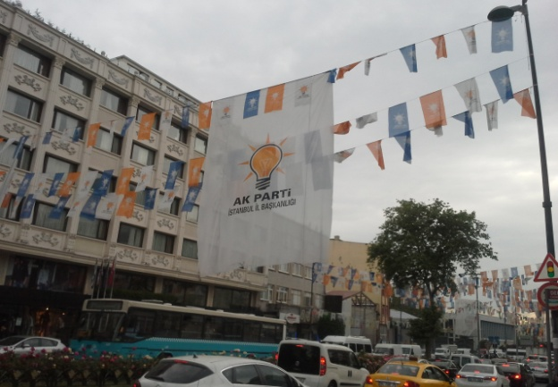
ELECTORAL MALPRACTICES IN TURKEY AND THEIR IMPACT ON POLITICAL REGIME
ECPR General Conference
Wrocław, 4-9 September 2019
Ass.Prof. Adam Szymański, University of Warsaw

Slide 2
Paper – part of the of the project
Project “Between Fair and Rigged. Elections as a Key Determinant of the ‘Borderline Political Regime’ - Turkey in Comparative Perspective”
Faculty of Political Science and International Studies, University of Warsaw, 2017-2020, financed by the Polish National Science Centre

Slide 3
Main research goals
Investigation of scope and dynamics of electoral malpractices in Turkey - violation of international standards concerning elections, at every stage of the electoral cycle and beyond it, putting strong emphasis on the normative approach, including the particularization of the electoral process.
Impact on the political system and regime in Turkey

Slide 4

Case - Turkey
The “hardest” cases to indicate the electoral malpractices and their impact on the political regime in the current decade.
A very good analytical example revealing the dilemmas in identification of electoral malpractices - due to insufficiently confirmed data, blurred boundaries with mispractices as well as difficulties in fulfilment of a very important criterion - i.e. substituting personal or partisan benefit of the particular for the public interest.

Slide 5
Main research question
Are elections in Turkey free, fair and competitive?
What types of electoral malpractices can be identified in this state?
Can we observe the change of their scope in subsequent elections?
How does the state of elections in terms of their fairness and competitiveness influence the political system and political regime?

Slide 6
Research hypothesis
Competitiveness limited by incumbents through rising electoral malpractices (in qualitative and quantitative dimension) can in the long run become a factor deciding not only about the change within the political regime (e.g. loss of democratic quality) and but also change of the regime (to less democratic one).

Slide 7
Main reseach focus
2011 parliamentary elections (49,85 per cent of votes for the AKP)
2014 local elections and presidential election (51,79 per cent of votes for the AKP presidential candidate)
Two parliamentary elections in 2015 (in June and November – 40,87 per cent and 49.50 per cent of votes respectively for the AKP)
2018 parliamentary and presidential elections (42,56 per cent of votes for the AKP and 52,59 per cent - for its presidential candidate).

Slide 8
Typology of electoral malpractices (Birch 2011)
Manipulation of the law
Manipulation of the vote choice
Mainipulation of the voting act

Slide 9
Data sources
EIP (2012-2019)
OSCE/ODIHR (2011-2018)
National NGOs reports
Semi-structured in-depth interviews - in Istanbul and Ankara in years 2018-2019 with Turkish experts in election law, elections and democratization in Turkey as well as journalists and [politicians].

Slide 10
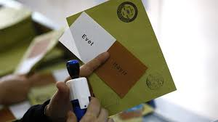
General findings – electoral malpractices in Turkey
Many legal deficits and mispractice
Malpractices present:
mainly manipulation of the law (first of all gerrymandering) and vote choice (media bias, misuse of state resources, undue impact) – usually use of incumbency advantage by the AKP – short- and long-term measures (clientelistic networks)
voting act – malpractices not necessary
till 2017 - particular atmosphere
(polarisation, populism, use of fears
and ideology),but change 2017-2018

Slide 11
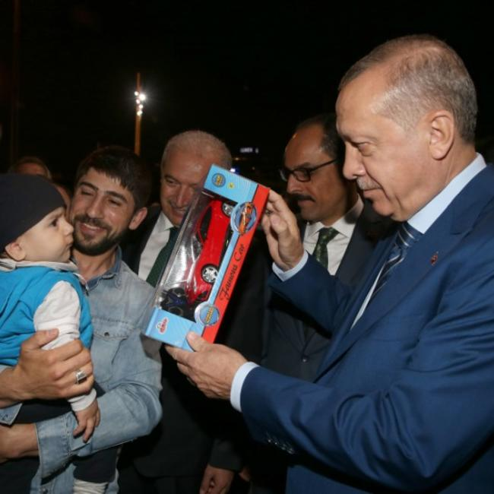
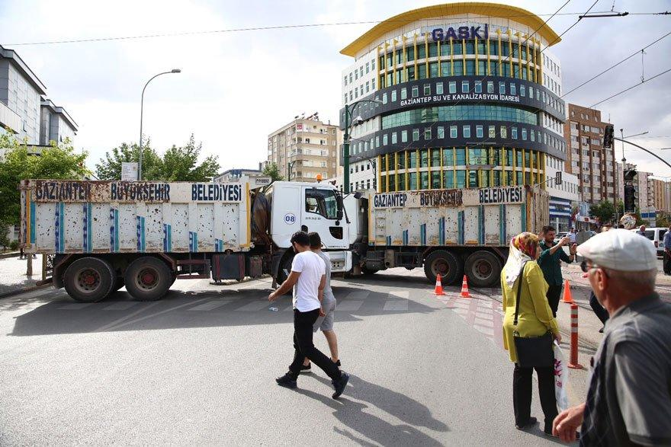
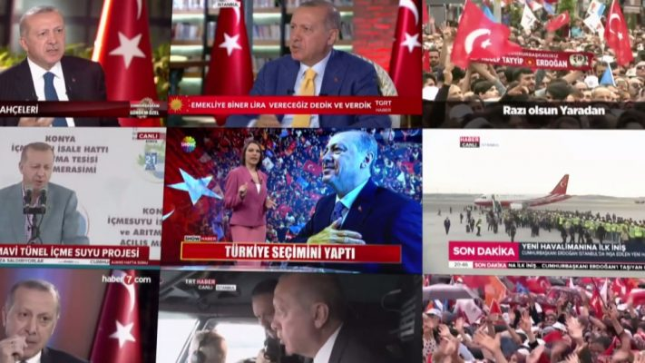
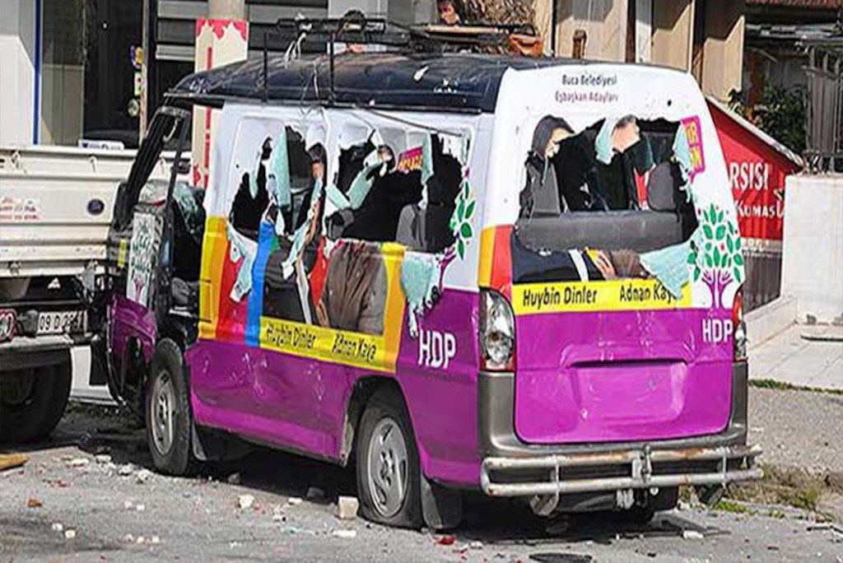
Manipulations of vote choice

Slide 12
Review – electoral malpractices (EIP, Norris and Grömping 2019)
Elections | Rank | PEI index | Electoral laws | Electoral procedures | District boundaries | Voter registr | Party and candidate registr. | Media coverage | Campaign finance | Voting process | Vote count | Results | Electoral authorities
2014 Aug Presidential elections | 206 | 51 | 43 | 62 | 56 | 58 | 51 | 27 | 29 | 53 | 68 | 68 | 53
2015 Jun Parliament. elections | 234 | 47 | 22 | 68 | 38 | 49 | 48 | 28 | 26 | 46 | 71 | 69 | 52
2015 Nov Parliament. elections | 250 | 44 | 28 | 60 | 45 | 51 | 43 | 25 | 24 | 43 | 61 | 68 | 45
2018 Jun Parliament. & Presidential Elections | 300 | 35 | 19 | 35 | 35 | 54 | 26 | 15 | 22 | 48 | 44 | 60 | 29

Slide 13
Electoral malpractices vs. political regime in Turkey
AKP LANDSLIDE VICTORY
(Rising)
electoral
malpractices
Political regime change
FEEDBACK MECHANISM (POSITIVE/NEGATIVE)

Slide 14
June 2011 parliamentary relations
Advanced consolidation of power of incumbents (AKP) - rising advantage - further state capture, development of patronage networks, increasing resources; pre-dominant party system; de-democratization through legislation and activtiies targetting e.g. freedom of expression and rule of law
August 2014 presidential elections
Further consolidation and centralization of AKP power, strengthening of the executive power (President) vs. judiciary and legislative power, continuation of de-democratization
June 2015 parliamentary elections
De-democratization intertwined with securitization (end of "peace process", escalation of Kurdish problem), limitation of political competition (HDP) - following results of election underming the AKP level of domination to date
November 2015 parliamentary elections
Introduction of the presidential system a la Turca, ruling by decrees, further marginalisation of the opposition, limited freedoms and rule of law under emergency rule and ruling through decrees
April 2017 Referendum
June 2018 parliamentary and presidential elections
Futher strengthening of the executive, development of the dominant party system and marginalisation of the opposition, further de-democratization, (media capture, limited freedoms) -intensification under emergency rule after July 2016 coup attempt (extensive control over state institutions)
Consolidation of the presidential system a la Turca , AKP still dominant party but alliance with MHP

Slide 15
Conclusions
We observed in 2011-2018 period the mutual reinforcement of electoral malpractices and change in the political regime to less democratic.
Dynamics of electoral malpractices basing on shifts along the line – full electoral integrity – lack of electoral integrity – influenced by the changes in the political system and regime in Turkey led within this decade to forming of the model which we can called “borderline regime”, i.e. the one that is balancing between the hybrid and new authoritarian regime.
Future of the hybrid regime uncertain – particularly in case of negative feedback.

Slide 16
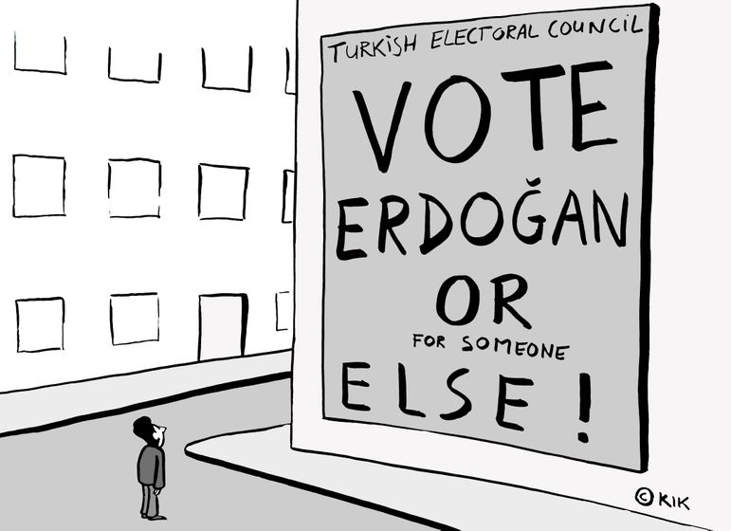
Thank you for your attention!

