Slide 1
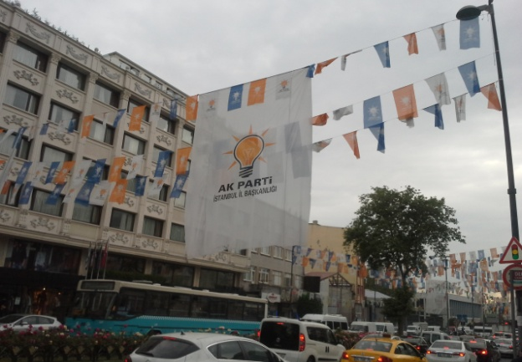
Between Fair and Rigged. Elections as a Key Determinant of the ‘Borderline Political Regime’ - Turkey in Comparative Perspective
Expert Seminar
Faculty of Political Science and International Studies, UW
3 December 2019

Slide 2
Project – Basic data
Faculty of Political Science and International Studies, University of Warsaw, 2017-2020, financed by the Polish National Science Centre, OPUS 11
Participants:
Principal investigator: Adam Szymański (University of Warsaw)
Investigators: Jakub Wódka (Polish Academy of Science), Wojciech Ufel (University of Wrocław), Amanda Dziubińska(University of Warsaw)

Slide 3
Main research goal
The analysis of dynamics of electoral malpractices at all stages of the electoral cycle and beyond it (focus on competitiveness), and their impact on the political regime and the democratization process - mainly in the current decade.

Slide 4
Specific theoretical goals
to test the theoretical framework to date concerning the electoral malpractice in order to prove that they are not always sufficient to explain the current phenomena being a result of the extensive use of different kind of electoral malpractices;
to propose: a) the model of interaction between the changing phenomena of electoral malpractice and political system/regime, b) the outline of concept of “borderline regimes” balancing between the hybrid and authoritarian regimes

Slide 5

Main Case
TURKEY
The “hardest” cases to indicate the electoral malpractices and their impact on the political regime.
A very good analytical example revealing the dilemmas in identification of electoral malpractices - due to insufficiently confirmed data, blurred boundaries with mispractices as well as difficulties in fulfilment of a very important criterion - i.e. substituting personal or partisan benefit of the particular for the public interest.

Slide 6
Comparative Cases I
Goal – Turkey sui generis case or not, are their common phenomena?
Selected cases:
Central Europe - Hungary
Balkans - Serbia, North Macedonia
Latin America - Nicaragua, Venezuela

Slide 7
Comparative Cases II
Selection criteria:
1.Problems with the liberal model of democracy reflected in the process of de-democratization
2. Noticeable similarities concerning malpractices at the different stages of the electoral process (incumbents advantage)
3. Common aspects of political systems of states, relevant for the malpractices and their consequences for the political regimes

Slide 8
Main research question
Are elections free, fair and competitive?
What types of electoral malpractices can be identified?
Can we observe the change of their scope in subsequent elections?
How does the state of elections in terms of their fairness and competitiveness influence the political system and political regime?

Slide 9
Research hypothesis I
H 1 – An increasing problem with the electoral integrity in Turkey and states compared with this country is caused first of all the deficits of the democratic culture of elites, enabling the development of the electoral malpractices.
H 2 – Instead of dichotomy of electoral integrity vs. lack of electoral integrity there is a continuum between two poles – scope of the electoral “menu of manipulation” determines the position within the continuum.

Slide 10
Research hypothesis II
H 3 – The development of the electoral malpractices affects the shape of a political and party system, and as a result - the political regime.
H 3.1 - A shift within the continuum to the direction of the pole of lack of the electoral integrity as a result of the increasing malpractices contributes – thanks to securing landslide victories of incumbents - to the enhancement of the dominant party system and slowing down of the democratization or even the de-democratization of a political system.
H 3.2- The dynamics of the “menu of manipulation” leads to the existence the “borderline regimes”, balancing between two types of regimes.
H 4 - Turkey and other states with “borderline regimes” are gradually approaching the less democratic regime – the situation influenced by the consequences of the dynamic development of the electoral malpractice.

Slide 11
Typology of electoral malpractices (Birch 2011)
Manipulation of the law
Manipulation of the vote choice
Mainipulation of the voting act

Slide 12
Data sources
EIP (2012-2019)
OSCE/ODIHR (2011-2018)
National NGOs reports, EU reports, Freedom House reports, IDEA, etc.
Semi-structured in-depth interviews - in Istanbul and Ankara in years 2018-2019 with Turkish experts in election law, elections and democratization in Turkey as well as journalists and NGO members.

Slide 13
General findings - theory
Definition of the electoral malpractices proposed by Birch is too narrow
Blurred boundaries between three categories of malpractices
Lack of inclusion of some types of malpractices (meta-malpractices, unequal access to law, prevention of taking a seat or post-electoral malpractices)

Slide 14
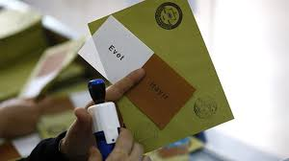
General empirical findings – electoral malpractices in Turkey (H2)
Many legal deficits and mispractices
Malpractices – dynamic phenomenon – ”menu of manipulation” at a certain time determines the position of the state within the continuum fair vs. rigged elections
Mainly ”manipulation of vote choice” (media bias, misuse of state resources, undue impact) – usually use of incumbency advantage by the AKP – short- and long-term measures (clientelistic networks) and of law
voting act – not necessary
till 2017 - particular atmosphere
(polarisation, populism, use of fears
and ideology),but change 2017-2018

Slide 15
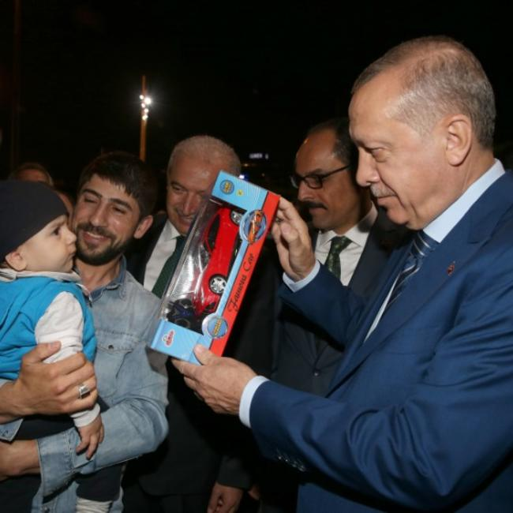
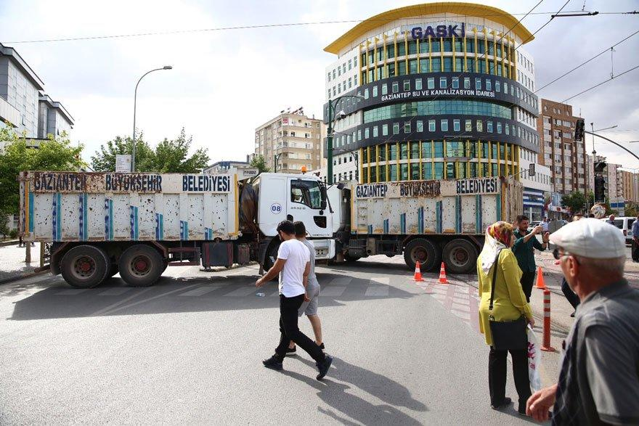
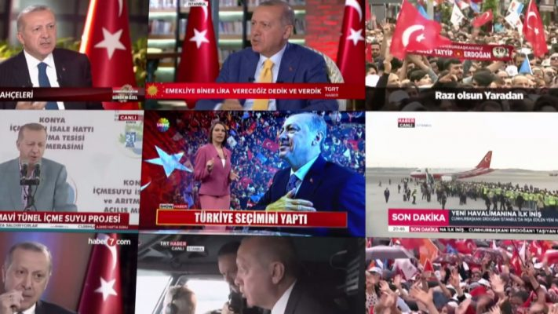
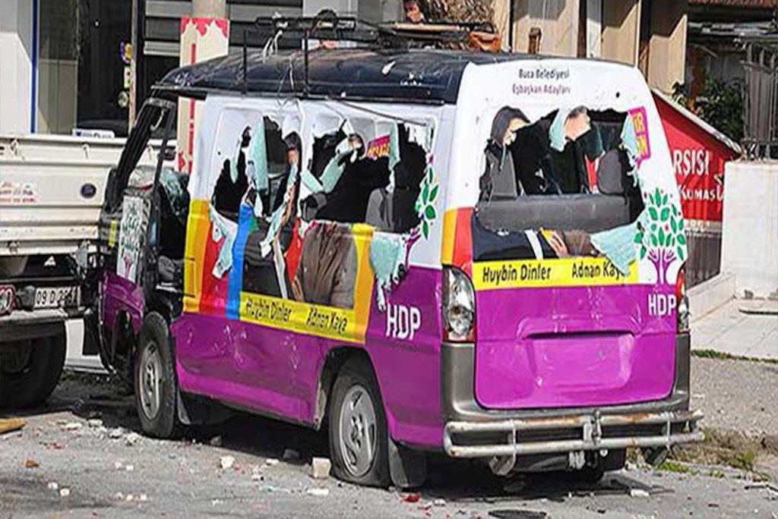
Manipulations of vote choice

Slide 16
Review – electoral malpractices (EIP, Norris and Grömping 2019)
Elections | Rank | PEI index | Electoral laws | Electoral procedures | District boundaries | Voter registr | Party and candidate registr. | Media coverage | Campaign finance | Voting process | Vote count | Results | Electoral authorities
2014 Aug Presidential elections | 206 | 51 | 43 | 62 | 56 | 58 | 51 | 27 | 29 | 53 | 68 | 68 | 53
2015 Jun Parliament. elections | 234 | 47 | 22 | 68 | 38 | 49 | 48 | 28 | 26 | 46 | 71 | 69 | 52
2015 Nov Parliament. elections | 250 | 44 | 28 | 60 | 45 | 51 | 43 | 25 | 24 | 43 | 61 | 68 | 45
2018 Jun Parliament. & Presidential Elections | 300 | 35 | 19 | 35 | 35 | 54 | 26 | 15 | 22 | 48 | 44 | 60 | 29

Slide 17
Political culture vs. electoral malpractices (H 1)
Motivation of incumbents who want not only to keep power but also consolidate it in their hands and later hegemonize it, rejecting the principle of its alteration as a result of elections.
Majoritarian understanding of democracy by incumbents which in practice is usually transformed into “tyranny of majority” allowing for the hegemonization of power.
Specific cases – „administrative culture” from Ottoman times (fear, suspicion and control)

Slide 18
Electoral malpractices vs. political regime in Turkey - mutual reinforcement
AKP LANDSLIDE VICTORY
(Rising)
electoral
malpractices
Increasing ”double domination” - political regime change
FEEDBACK MECHANISM
1. POSITIVE
2. NEGATIVE (”Political Uncertainty”)

Slide 19
June 2011 parliamentary relations
Advanced consolidation of power of incumbents (AKP) - rising advantage - further state capture, development of patronage networks, increasing resources; pre-dominant party system; de-democratization through legislation and activtiies targetting e.g. freedom of expression and rule of law
August 2014 presidential elections
Further consolidation and centralization of AKP power, strengthening of the executive power (President) vs. judiciary and legislative power, continuation of de-democratization
June 2015 parliamentary elections
De-democratization intertwined with securitization (end of "peace process", escalation of Kurdish problem), limitation of political competition (HDP) - following results of election underming the AKP level of domination to date
November 2015 parliamentary elections
Introduction of the presidential system a la Turca, ruling by decrees, further marginalisation of the opposition, limited freedoms and rule of law under emergency rule and ruling through decrees
April 2017 Referendum
June 2018 parliamentary and presidential elections
Futher strengthening of the executive, development of the dominant party system and marginalisation of the opposition, further de-democratization, (media capture, limited freedoms) -intensification under emergency rule after July 2016 coup attempt (extensive control over state institutions)
Consolidation of the presidential system a la Turca , AKP still dominant party but alliance with MHP

Slide 20
Conclusions – H3 and H4
We observed in 2011-2018 period the mutual reinforcement of electoral malpractices and change in the political regime to less democratic
Dynamics of electoral malpractices basing on shifts along the line – full electoral integrity – lack of electoral integrity – influenced by the changes in the political system and regime in Turkey led within this decade to forming of the model which we can called “borderline regime”, i.e. the one that is balancing between the hybrid and new authoritarian regime.
Future of the hybrid regime uncertain – particularly in case of negative feedback.

Slide 21
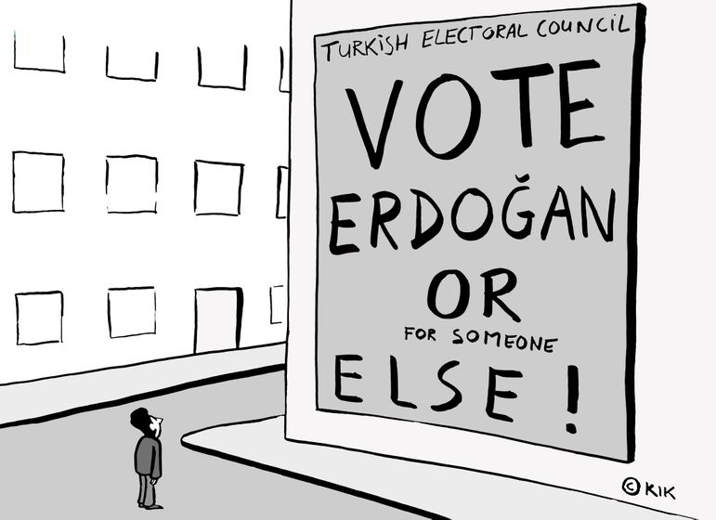
Thank you for your attention! http://www.inp.uw.edu.pl/projekt_wybory_turcja/en/

