Slide 1
DE-DEMOCRATIZATION OF
TURKEY AND CENTRAL AND EASTERN EUROPE – THE CASE OF ELECTIONS
Kraków, 4-6 September 2017
Prof. Adam Szymański, University of Warsaw
Dr Jakub Wódka, Polish Academy of Science, Warsaw
Wojciech Ufel, MA, University of Wrocław

Slide 2
Paper – initial phase of the project
Project “Between Fair and Rigged. Elections as a Key Determinant of the ‘Borderline Political Regime’ - Turkey in Comparative Perspective”
Faculty of Political Science and International Studies, University of Warsaw, 2017-2018, financed by the Polish National Science Centre

Slide 3
Main research goal
Contribution to the development of the research on the de-democratization thanks to carrying out the analysis of the state of elections in selected countries in Europe and its neighborhood as the crucial democratic institution.
It can help to identify better not only the phenomenon of de-democratization but also the types of regimes existing nowadays in this region.

Slide 4
Research focus
Competitiveness of elections – crucial for regime type; electoral malpractice
Recent elections in selected countries
a) Main case - Turkey – 2014 presidential elections, 2015 parliamentary elections
b) Comparative cases:
Belarus – 2015 presidential elections, 2016 parliamentary elections
Serbia – 2016 parliamentary elections, 2017 presidential elections
Hungary – 2014 parliamentary elections

Slide 5
Main research question
Are elections in the selected countries free, fair and competitive?
Can some types of electoral malpractice and irregularities be identified?
How does the state of elections in terms of their fairness and competiveness influence the political regime?
What does it tell us about the EU impact on political systems of states being EU members or associated members?

Slide 6
Research hypothesis
In the countries in Europe and its close neighborhood elections’ competitiveness limited by incumbents can in the long run become a factor deciding not only about a change within the political regime (e.g. loss of democratic quality) and but also a change of the regime (to less democratic one).

Slide 7
Electoral malpractice
The violation of electoral integrity, i.e. violation of internationally accepted standards of elections throughout the whole electoral cycle - in the pre-electoral period, during the campaign, on the voting day as well as after the elections
Malpractice vs. ‘mispractice’

Slide 8
Typology of electoral malpractices (Birch 2011)
Manipulation of the law
Manipulation of the vote choice
Mainipulation of the voting act

Slide 9
Electoral malpractices in Turkey
Electoral Integrity Project ranking:
August 2014 presidential elections – 86th place (127 countries)
2015 parliamentary elections – 101st place (135 countries)
OSCE reports – although legal improvements, still defective or ambigous regulations > malpractices

Slide 10
General findings – electoral malpractices in Turkey
Many legal deficits and mispractice
Malpractices also present:
mainly manipulation of the law (first of all gerrymandering) and vote choice (media bias, misuse of state resources, undue impact) – usually use of incumbency advantage by the AKP – short- and long-term measures (clientelistic networks)
voting act – fraud, etc. not necessary – particular atmosphere (polarisation, populism, use of fears and ideology)

Slide 11
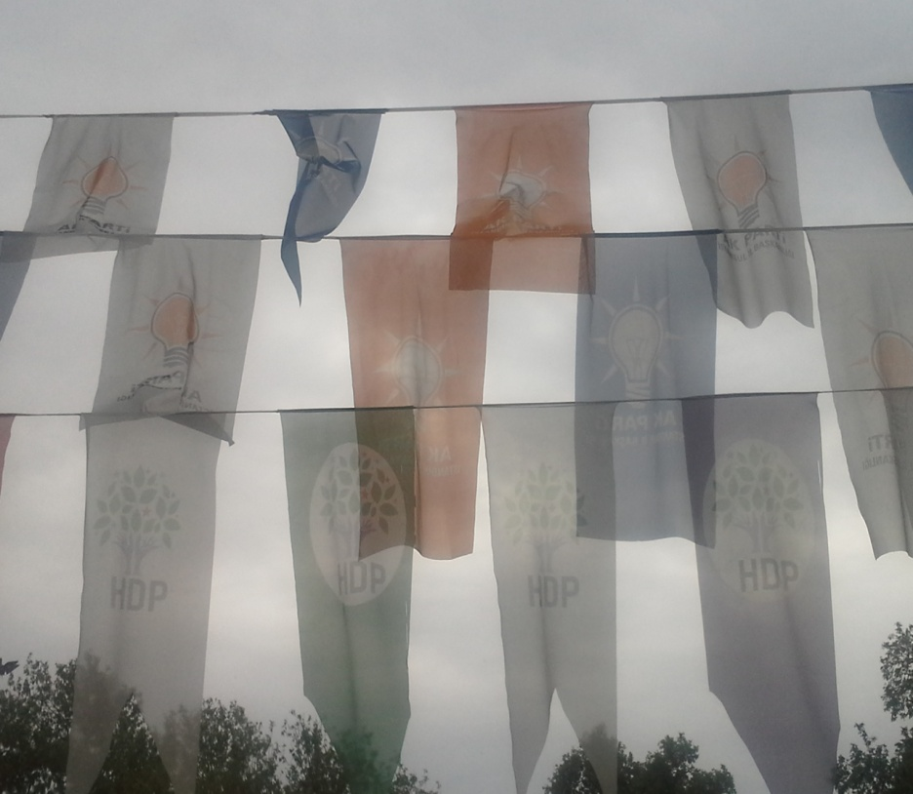
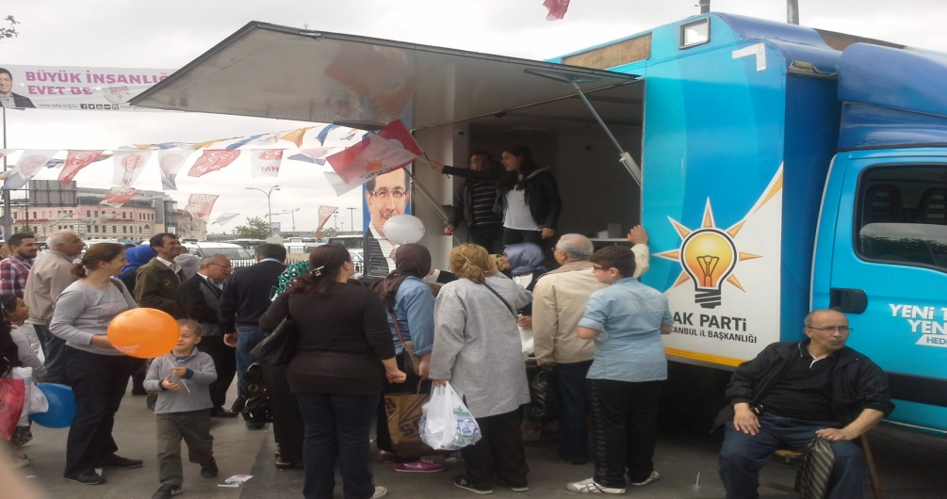
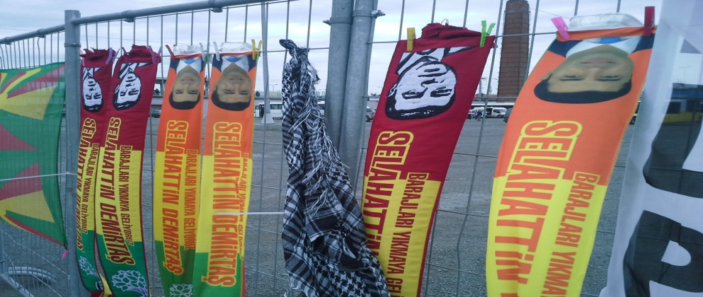
Manipulation of vote choice

Slide 12
Other cases – Electoral laws (EIP 2017)
country | favoredincumbent | favoredincumbent2 | legalelections
Turkey | 4,1055555 | 1,8944445 | 3,5333333
Belarus | 4,0238094 | 1,9761904 | 2,5627706
Hungary | 4,375 | 1,625 | 4,0625
Serbia | 3,5769231 | 2,4230769 | 3,6394231

Slide 13
Other cases – Media bias (EIP 2017)
country | newspapers | tv | tv2 | fairaccess | faircoverage | socialmedia
Turkey | 1,555556 | 4,488889 | 1,511111 | 1,572222 | 1,8 | 3,916162
Belarus | 1,587121 | 4,265152 | 1,734849 | 1,862554 | 2,095238 | 3,523809
Hungary | 2,066667 | 4,4 | 1,6 | 1,6 | 2,466667 | 3,571429
Serbia | 2,288462 | 4,149038 | 1,850962 | 2,480769 | 2,1875 | 3,539683

Slide 14
Other cases – Campaining finances (EIP 2017)
country | subsidies | donations | accounts | rich | rich2 | state resources | state resources2
Turkey | 2,202525 | 1,800357 | 1,63025 | 2,853801 | 3,146199 | 4,655556 | 1,344444
Belarus | 2,077922 | 1,839394 | 1,844445 | 2,222222 | 3,777778 | 4,628788 | 1,371212
Hungary | 3,25 | 2,642857 | 1,733333 | 3 | 3 | 4,1875 | 1,8125
Serbia | 2,958334 | 2,386364 | 1,784091 | 2,875 | 3,125 | 4,350649 | 1,649351

Slide 15
Conclusions
1. Despite the differences in details, in all analyzed states the incumbents have resorted to a plethora of means inhibiting their competitiveness, distorting the level playing field by limiting the access of opposition parties to resources, be it media or financial and administrative assets as well as by manipulating the electoral laws and procedures included in these laws.

Slide 16
Conclusions
2. Although all these countries made in the past a relative progress in the democratization process (certainly to different degree in each case), which was influenced also by the European Union within the mechanism of conditionality, the current phenomenon concerning the elections and their integrity reveals that the EU is in one more crisis as a normative power and „stabilizer” of new political regimes.

Slide 17
Conclusions
3. The electoral malpractices contribute substantially to shifting the party system to the dominant party model - (coalitions in some cases change a little, Belarus – exception as far as party system is concerned) together with the marginalization of opposition.
When we add to this the populist policy and use of clientelistic networks of different type, we see the challenge for the unconsolidated democracies or countries in a transition to the democratic regime.

Slide 18
Conclusions
4. Negative contribution of malpractices (de-democratization – complex phenomenon):
Short-term&direct – they are themselves manifestations of problems in the democratization process
Long-term&indirect – change of the political regime for a less democratic one also possible (not only within the regime) - as a result of the increasingly unlimited and uncontrolled power of incumbents whose policy is strengthening the authoritarian tendencies observed in a particular country.

Slide 19
Thank you for your attention!
Website of the project:
http://www.inp.uw.edu.pl/projekt_wybory_turcja/en

