Slide 1
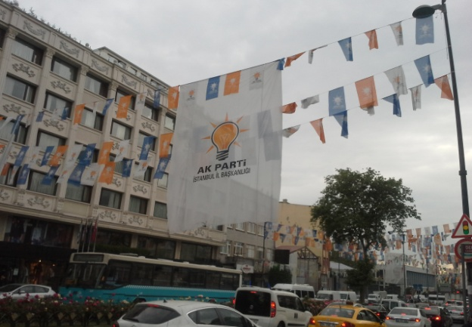
ELECTIONS IN TURKEY - CHASING AFTER THE “CAT”
Lisbon, 1-3 February 2017
Prof. Adam Szymański, University of Warsaw
Dr Jakub Wódka, Polish Academy of Science, Warsaw

Slide 2
Studies on electoral integrity and malpractice
S. Birch (2011)
P. Norris (2014, 2015)
A. Schedler (2002, 2006, 2009, 2013)
A. Simpser (2013)

Slide 3
Paper – initial phase of the project
Project “Between Fair and Rigged. Elections as a Key Determinant of the ‘Borderline Political Regime’ - Turkey in Comparative Perspective”
Faculty of Political Science and International Studies, University of Warsaw, 2017-2018, financed by the Polish National Science Centre

Slide 4
Main research question
The paper seeks to survey the extent of election malpractices in Turkey and, without prejudging, address a fundamental question [concerning the impact on the political regime]:
Do elections in Turkey, notwithstanding the irregularities, still meet democratic, international standards, or is Turkey sliding into electoral autocracy, with AKP “faking” the democratic regime?

Slide 5
Electoral malpractice
The violation of electoral integrity, i.e. violation of internationally accepted standards of elections throughout the whole electoral cycle - in the pre-electoral period, during the campaign, on the voting day as well as after the elections
Malpractice vs. ‘mispractice’

Slide 6
Research focus
March 2014 local elections
August 2014 presidential elections
June 2015 parliamentary elections
November 2015 parliamentary elections
However, sometimes also earlier elections (2009, 2011)- to show particular processes.

Slide 7
Typology of electoral malpractices (Birch 2011)
Manipulation of the law
Manipulation of the vote choice
Mainipulation of the voting act

Slide 8
Electoral malpractices in Turkey
Electoral Integrity Project ranking:
August 2014 presidential elections – 86th place (127 countries)
2015 parliamentary elections – 101st place (135 countries)
OSCE reports – although legal improvements, still defective or ambigous regulations > malpractices

Slide 9
General findings – electoral malpractices in Turkey
Many legal deficits and mispractice
Malpractices also present:
mainly manipulation of the law (first of all gerrymandering) and vote choice (media bias, misuse of state resources, undue impact) – usually use of incumbency advantage by the AKP – short- and long-term measures (clientelistic networks)
voting act – fraud, etc. not necessary – particular atmosphere (polarisation, populism, use of fears and ideology)

Slide 10
General findings – electoral malpractices vs. political regime in Turkey
Malpractices contribute substantially to the process of shifting of pre-dominant party system to the dominant one – continuation of strengthening of majoritarianism (since the 1980s)
In the long run the electoral malpractices in Turkey can contribute not only to the change within the hybrid regime but also to the transformation of the regime from the hybrid one to some type of electoral authoritarianism

Slide 11
General findings – electoral malpractices vs. political regime in Turkey
Negative contribution of malpractices:
direct – part of authoritarian tendencies
indirect - an ever increasing domination of the AKP in the party and political system consolidated as a result of subsequent elections as well as more and more restrictive political “level playing field’ have adverse consequences for the political regime due to the specter of “tyranny of majority.”

Slide 12
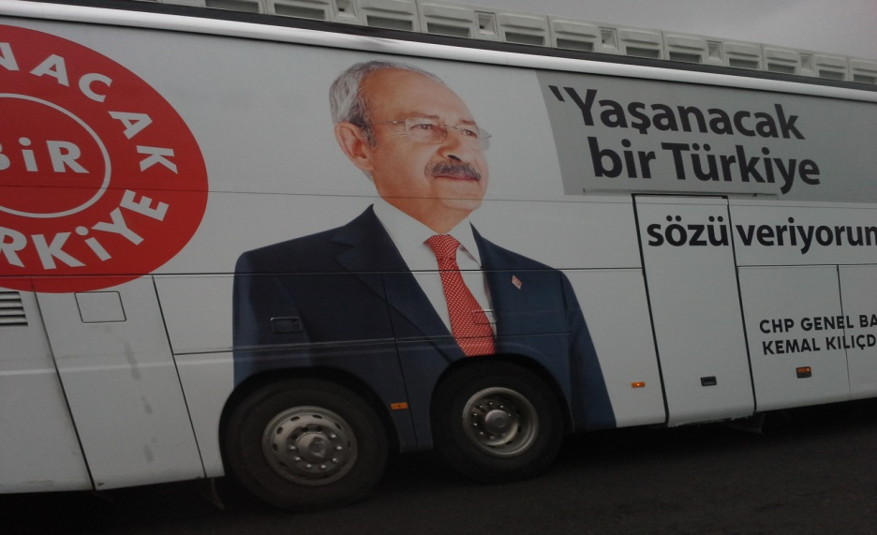
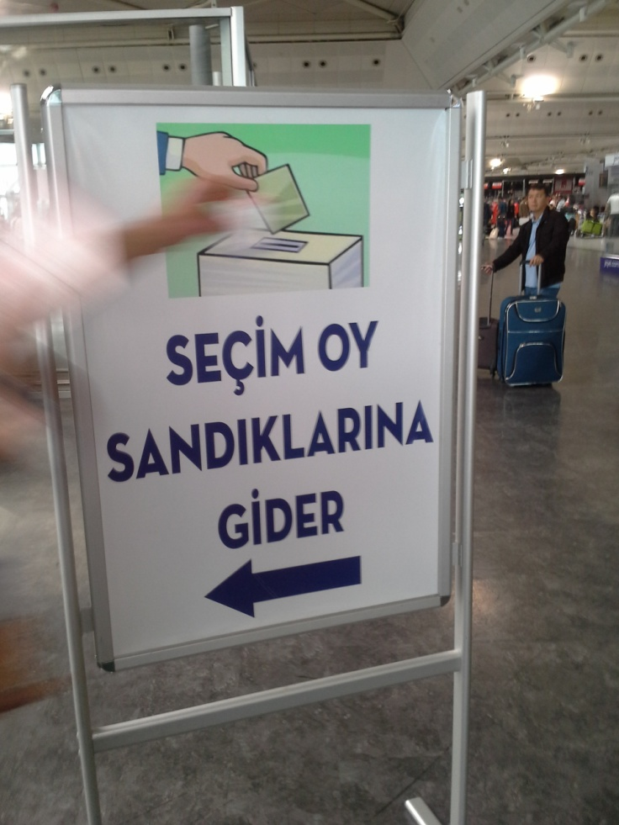
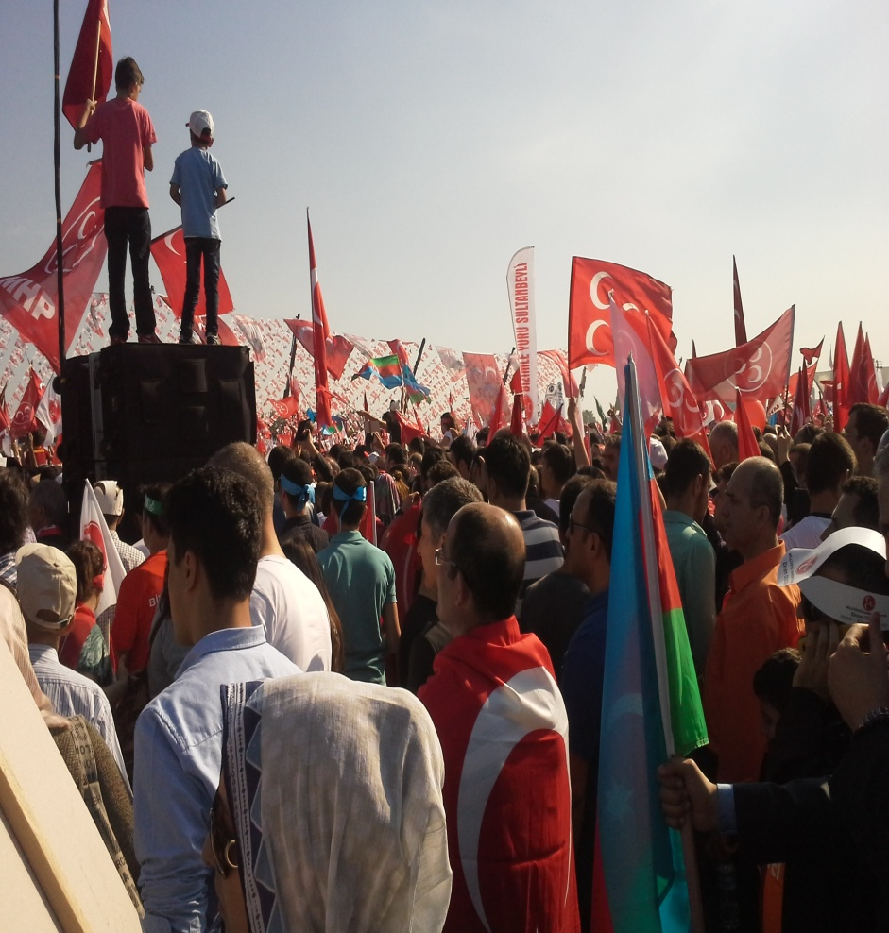
Thank you for your attention!

