Slide 1
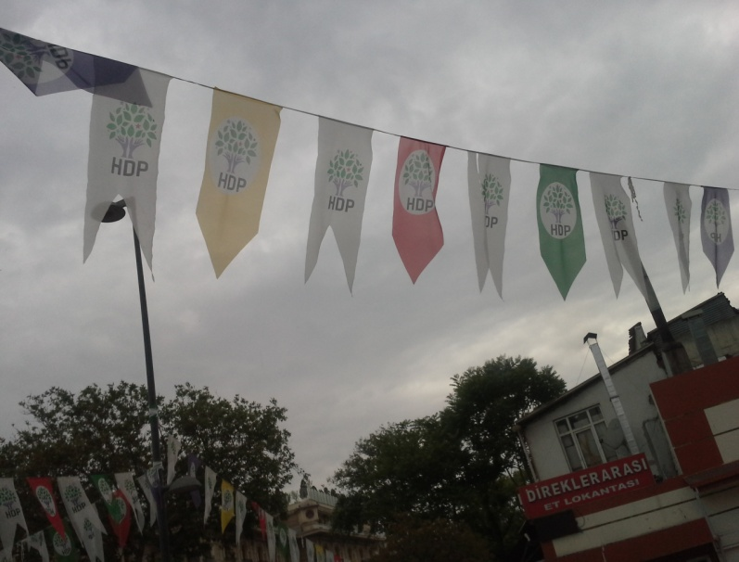
Competitiveness of Elections in Turkey – The Case of Pro-Kurdish Party
Nicosia, 24-27 June 2017
Prof. Adam Szymański, University of Warsaw

Slide 2
Paper – initial phase of the project
Project “Between Fair and Rigged. Elections as a Key Determinant of the ‘Borderline Political Regime’ - Turkey in Comparative Perspective”
Faculty of Political Science and International Studies, University of Warsaw, 2017-2018, financed by the Polish National Science Centre

Slide 3
Research focus
1)Electoral competitiveness – minorities – case of People’s Democratic Party (HDP)
2) Elections:
March 2014 local elections
August 2014 presidential elections
June 2015 parliamentary elections
November 2015 parliamentary elections
However, sometimes also earlier elections (2009, 2011)- to show particular processes.

Slide 4
Hypotheses
H1 – The limited chances of candidates of pro-Kurdish parties to compete with the AKP candidates are a result of presence of increasing number of electoral malpractices that could be identified in this state.
H2 - The development of these electoral malpractices goes hand in hand with the rise of authoritarian tendencies in the AKP era - unfavorable for the position of minorities and with the increasingly negative attitude of the Turkish government towards the pro-Kurdish political forces.

Slide 5
Electoral malpractice
The violation of electoral integrity, i.e. violation of internationally accepted standards of elections throughout the whole electoral cycle - in the pre-electoral period, during the campaign, on the voting day as well as after the elections
Malpractice vs. ‘mispractice’

Slide 6
Research questions
Do elections laws and their implementation give candidates of pro-Kurdish parties a chance to compete equally with biggest parties, first of all AKP, in elections?
Did the political reforms improve the situation in this context?
How do the observed authoritarian tendencies in Turkey in this decade influence the possibilities of equal participation of candidates of the pro-Kurdish parties in elections?
What is the impact of the relationship between the government and pro-Kurdish political forces on these possibilities?

Slide 7
Studies on electoral integrity and malpractice
S. Birch (2011)
P. Norris (2014, 2015)
A. Schedler (2002, 2006, 2009, 2013)
A. Simpser (2013)

Slide 8
Typology of electoral malpractices (Birch 2011)
Manipulation of the law
Manipulation of the vote choice
Mainipulation of the voting act

Slide 9
Electoral malpractices in Turkey
Electoral Integrity Project ranking:
August 2014 presidential elections – 86th place (127 countries)
2015 parliamentary elections – 101st place (135 countries)
OSCE reports – although legal improvements, still defective or ambigous regulations > malpractices

Slide 10
Electoral malpractices – HDP case
Some legal improvements – e.g. use of Kurdish language in campaign – till 2014
After 2014 – more malpractices – particularly November 2015 elections
Manipulation of the vote choice – main problem

Slide 11
Manipulation of vote choice - example I
MEDIA BIAS
2014 presidential elections – TV airtime
Erdoğan 47.000 broadcasting time units
İhsanoğlu –16.000 units
Demirtaş – only 5.000 units
November 2015 parliamentary elections - Pro-Kurdish media were raided by the police; many Kurdish journalists were arrested

Slide 12
Manipulation of vote choice - example II
MISUSE OF STATE RESOURCES AND AND VIOLATION OF CAMPAIGN FINANCE REGULATIONS
Individual financial support – 2014 presidential elections:
Erdoğan - about 24 million Turkish liras
İhsanoğlu – 2.1 million Turkish liras
Demirtaş - about 360.000 Turkish liras
State funds given to HDP first after the elections (November 2015)

Slide 13
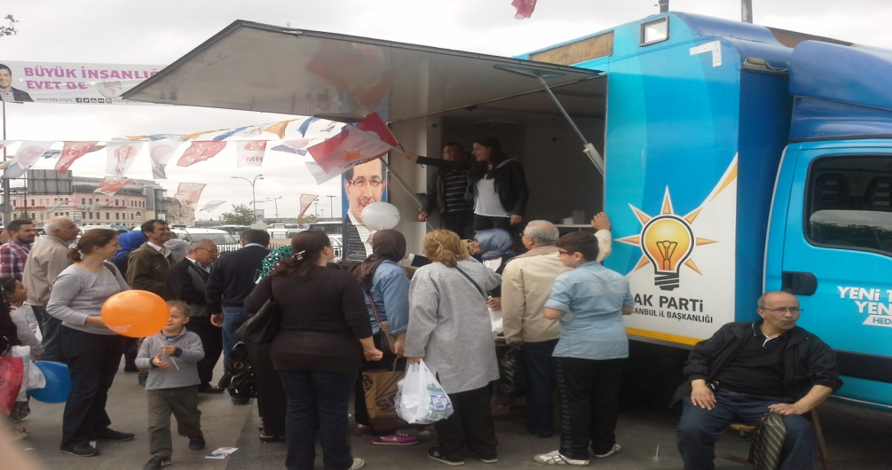
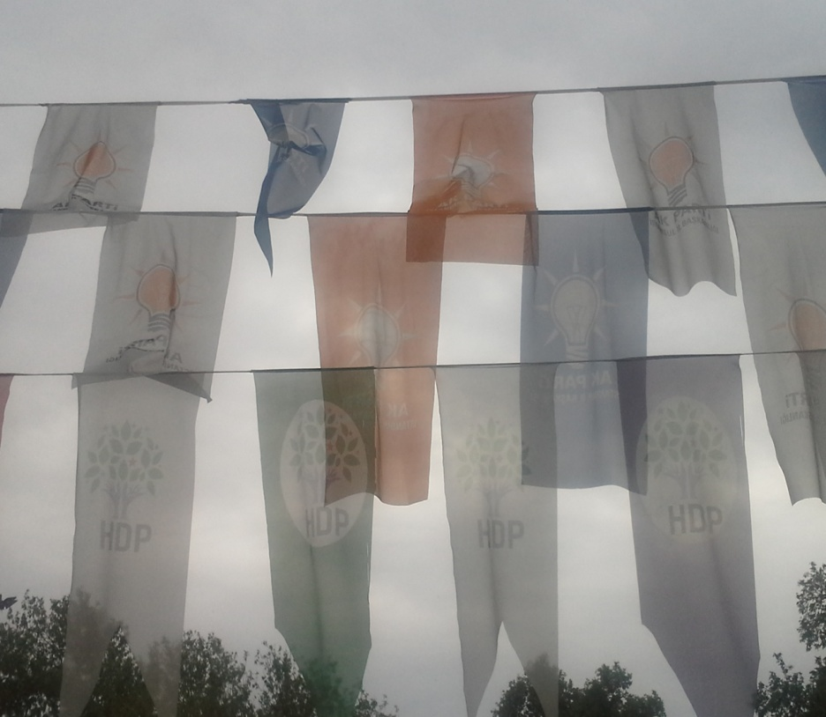
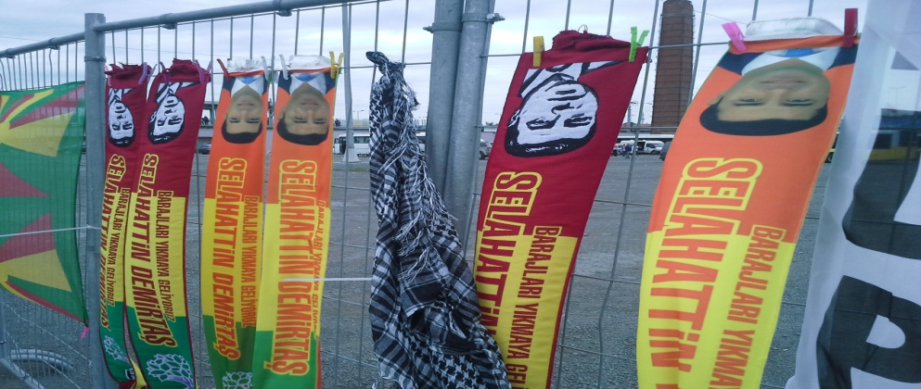
Manipulation of vote choice - example II
Elections rallies and campaign on the streets

Slide 14
Manipulation of vote choice - example III
INTIMIDATION OF CANDIDATES OR
OBSTRUCTION OF THEIR CAMPAIGN ACTIVITIES
November 2015
Intensification of negative media coverage - very clear in the pro-government media reporting on HDP.
From 187 attacks against political parties during the election period, 168 were directed against HDP politicians.
More than 5,000 members of the party were taken into custody.

Slide 15
Conclusions
The electoral chances are limited in the case of the pro-Kurdish HDP. This phenomenon is mainly a result of the manipulation of the vote choice.
Manipulation of the law – single examples; also manipulation of the voting act not needed (until 2017 referendum) - evoking basic fears (e.g. of losing stability) and ideological concerns (first of all nationalism) by the AKP

Slide 16
Conclusions
The electoral manipulations limiting the competitiveness of elections and electoral chances of the HDP are to a certain extent a function of the development of the de-democratization process in Turkey.
However, even more important in the case of the pro-Kurdish party is the state of the relationship between the government and the pro-Kurdish forces.

Slide 17
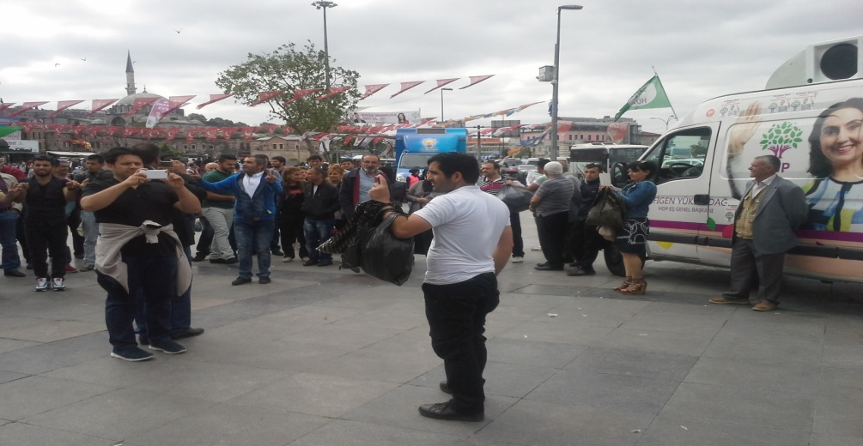
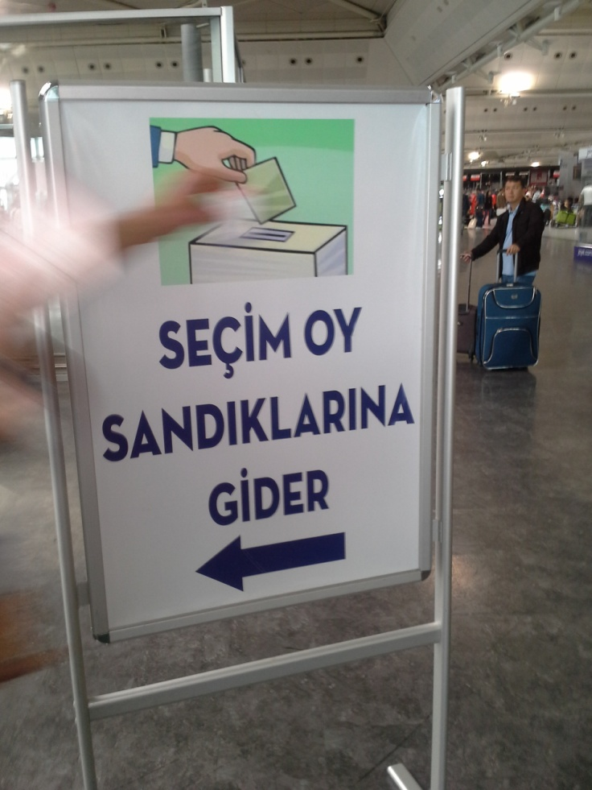
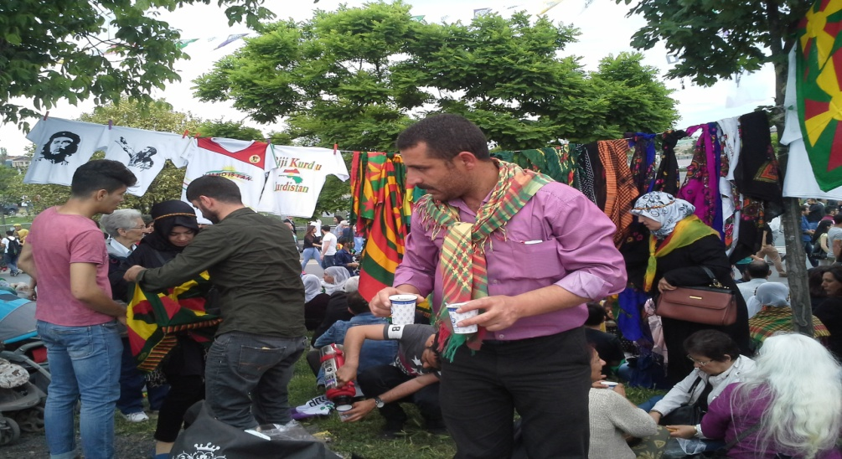
Thank you for your attention!

