Slide 1
Beyond vote rigging: common patterns in electoral malpractices in de-democratizing regimes Toruń, 5 December 2017
Prof. Adam Szymański, University of Warsaw
Wojciech Ufel, MA, University of Wrocław

Slide 2
Paper – initial phase of the project
Project “Between Fair and Rigged. Elections as a Key Determinant of the ‘Borderline Political Regime’ - Turkey in Comparative Perspective”
Faculty of Political Science and International Studies, University of Warsaw, 2017-2018, financed by the Polish National Science Centre

Slide 3
Main research goal
Contribution to the development of the research on the de-democratization thanks to carrying out the analysis of the state of elections in selected countries in Europe and its neighborhood as the crucial democratic institution.
It can help to identify better not only the phenomenon of de-democratization but also the types of regimes existing nowadays in this region.

Slide 4
Research focus
Competitiveness of elections – crucial for regime type; electoral malpractice
Recent elections in selected countries
a) Main case - Turkey – 2014 presidential elections, 2015 parliamentary elections
b) Comparative cases:
Belarus (control case) – 2015 presidential elections, 2016 parliamentary elections
Hungary – 2014 parliamentary elections
Macedonia – 2014 parliamentary and presidential elections, 2016 (June/December) parliamentary elections
Serbia – 2016 parliamentary elections, 2017 presidential elections

Slide 5
Main research question
Are elections in the selected countries free, fair and competitive?
Can some types of electoral malpractice and irregularities be identified?
How does the state of elections in terms of their fairness and competiveness influence the political regime?
What does it tell us about the EU impact on political systems of states being EU members or associated members?

Slide 6
Research hypothesis
In the countries in Europe and its close neighborhood elections’ competitiveness limited by incumbents can in the long run become a factor deciding not only about a change within the political regime (e.g. loss of democratic quality) and but also a change of the regime (to less democratic one).

Slide 7
Electoral malpractice
The violation of electoral integrity, i.e. violation of internationally accepted standards of elections throughout the whole electoral cycle - in the pre-electoral period, during the campaign, on the voting day as well as after the elections
Malpractice vs. ‘mispractice’

Slide 8
Typology of electoral malpractices (Birch 2011)
Manipulation of the law
Manipulation of the vote choice
Mainipulation of the voting act

Slide 9
Electoral malpractices in Turkey
Electoral Integrity Project ranking:
August 2014 presidential elections – 86th place (127 countries)
2015 parliamentary elections – 101st place (135 countries)
OSCE reports – although legal improvements, still defective or ambigous regulations > malpractices

Slide 10
General findings – electoral malpractices in Turkey
Many legal deficits and mispractice
Malpractices also present:
mainly manipulation of the law (first of all gerrymandering) and vote choice (media bias, misuse of state resources, undue impact) – usually use of incumbency advantage by the AKP – short- and long-term measures (clientelistic networks)
voting act – fraud, etc. not necessary – particular atmosphere (polarisation, populism, use of fears and ideology)

Slide 11
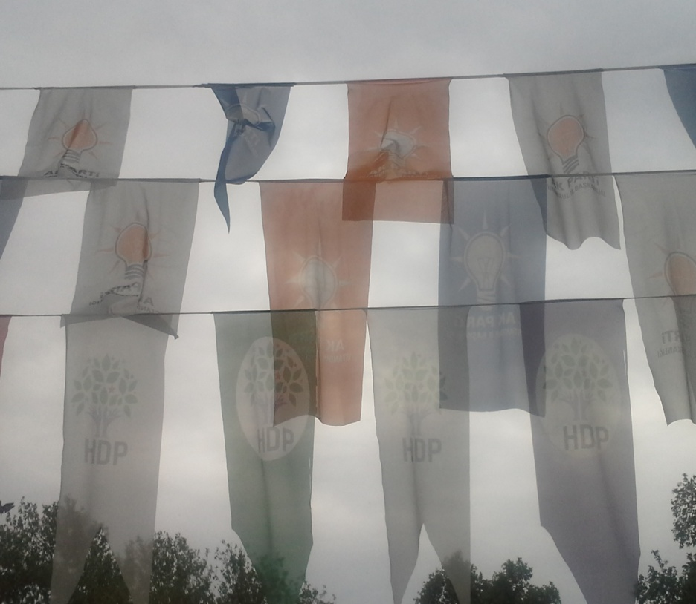
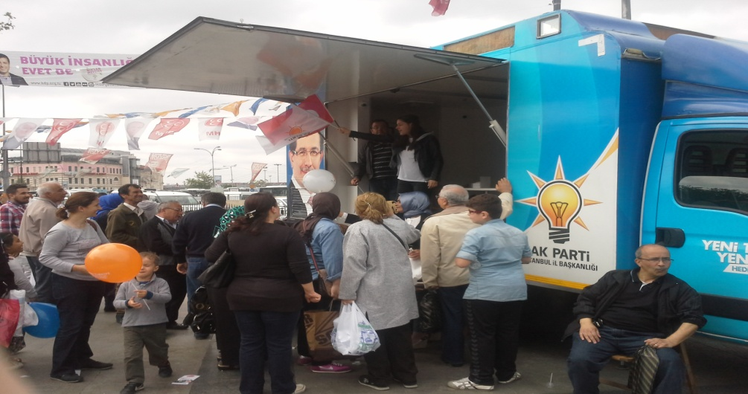
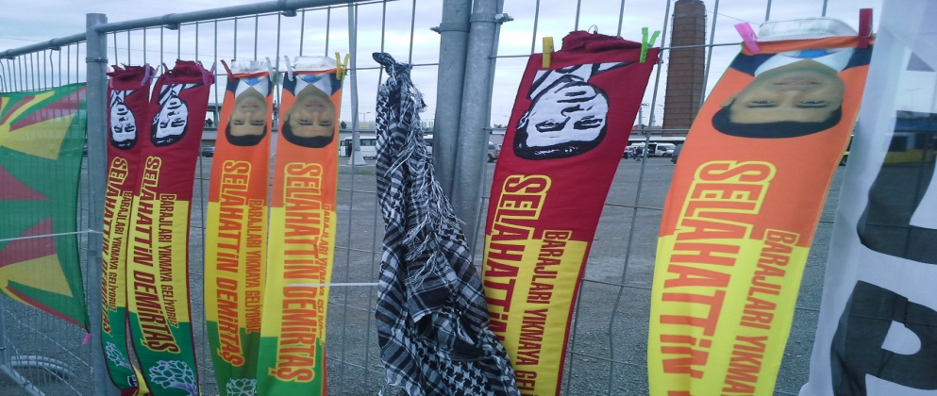
Manipulation of vote choice

Slide 12
Other cases – General overview (EIP 2017)
country | PEIIndexi | PEI rank | laws | proceduresi | boundaries | media | finance | voting
Turkey | 47,39484151 | 115 | 44,763 | 63,368 | 55,3812 | 41,592 | 38,884 | 57,409
Hungary | 56,18782043 | 75 | 44,188 | 69,394 | 44,466 | 45,428 | 47,667 | 69,772
Macedonia | 47,72746468 | 113 | 52,147 | 56,440 | 52,572 | 40,157 | 39,210 | 53,526
Serbia | 48,47156779 | 111 | 50,063 | 59,902 | 60,565 | 34,314 | 34,444 | 52,604
Belarus | 39,47262319 | 136 | 38,900 | 43,926 | 67,611 | 34,222 | 39,778 | 56,111

Slide 13
Other cases – Electoral laws (EIP 2017)
country | Electoral malpractices | Comments
Hungary | Amendments to voting system, high tolerance for malapportionment, allegations of gerrymandering, limitations to out-of-country voting | Changes to Electoral Code, as well as the major change of the Constitution.
Macedonia | Mistrust in a voter-list, limitations to out-of-country voters, malapportionment, attempt at launching noncompetitive elections. | Malpractices has been corrected through a facilitation of international actors (esp. EU)
Serbia | Nonclear and overly burdensome procedures for candidate registration, insufficient rules for financial auditing, inaccurate voters lists.
Belarus | Permissive system of voter’s registration, limitations to candidate registration and campaigning, unequal access to resources.

Slide 14
Other cases – Media bias (EIP 2017)
country | Malpractices | Comments
Hungary | Biased media coverage, ownership of private media by people connected to FIDESZ, lack of political balance in Media Council
Macedonia | Biased (public and private) media coverage due to state dominance in advertising market (self-censorship), failure of media to distinguish coverage of candidates and public officials
Serbia | Low media coverage of campaigning – expensive advertising, state activities of officials dominate coverage, incumbent favoured by all private and public tv outlets and most papers
Belarus | Lack of media coverage did not allow voters to make an informed choice, state media were biased and favoured incumbent, obstruction of work of journalists | Despite some fair coverage in private media, their influence is very limited.

Slide 15
Other cases – Campaign finances/state resources (EIP 2017)
country | Malpractices | Comments
Hungary | State-financed campaign was cheaply sold to FIDESZ during elections, campaign activities blurring division of state and party, some NGOs actively campaigning for incumbent (without and oversight) | Additionally, broad clientelists networks were used to finance FIDESZ
Macedonia | Broad involvement of civil servants in the proces (corruption and intimidation), significant advantage of incumbent over other candidates
Serbia | Significant advantage of incumbent over other candidates, insufficient control over private donations.
Belarus | Lack of transparency, illegal suport of many NGOs for the incumbent, business and civil servants intimidation, misuse of state resources for the sake of campaigning. | Many candidates did not campaign, which led to questioning their genuineness

Slide 16
Conclusions
Despite the differences in details, in all analyzed states the incumbents have resorted to a plethora of means inhibiting their competitiveness, distorting the level playing field by:
Discreetly manipulating the electoral law, administration and procedures (salami tactics)
Deliberatly limiting the access of opposition parties to resources, especially media or financial and administrative assets

Slide 17
Conclusions
Two campaigning strategies has been implemented in compared cases:
Extreme rivalry – high intensity campaigning, extensive advertising, blackmailing and accusations against rivals, anti-systemic rhetorics of „total war” (Turkey, Hungary)
Non-campaigning – low intensity campaigning, lack of debates and advertising, low public interest in voting (Serbia, Macedonia June 2016, Belarus)

Slide 18
Conclusions
3. Although all these countries made in the past a relative progress in the democratization process (certainly to different degree in each case), which was influenced also by the EU within the mechanism of conditionality, the current phenomenon concerning the elections and their integrity reveals that the EU is in one more crisis as a normative power and „stabilizer” of new political regimes.
- However, the case of Macedonia shows, that a combined effort of political opposition, citizens and external institutions, can positively influence the fairness of elections.

Slide 19
Conclusions
4. The electoral malpractices contribute substantially to shifting the party system to the dominant party model - (coalitions in some cases change a little, Belarus – exception as far as party system is concerned) together with the marginalization of opposition.
When we add to this the populist policy and use of clientelistic networks of different type, we see the challenge for the unconsolidated democracies or countries in a transition to the democratic regime.

Slide 20
Conclusions
5. Negative contribution of malpractices (de-democratization – complex phenomenon):
Short-term&direct – they are themselves manifestations of problems in the democratization process
Long-term&indirect – change of the political regime for a less democratic one also possible (not only within the regime) - as a result of the increasingly unlimited and uncontrolled power of incumbents whose policy is strengthening the authoritarian tendencies observed in a particular country.

Slide 21
Thank you for your attention!
Website of the project:
http://www.inp.uw.edu.pl/projekt_wybory_turcja/en

